Slide 1
Vista Project Building a Holistic ATM Model for Future KPI Trade-Offs
Gérald Gurtner, Luis Delgado, Andrew Cook
Jorge Martín, Samuel Cristóbal
Hans Plets
SESAR Innovation Days
28th November 2017
Belgrade

Slide 2
Goals and objectives
Vista aims to study the main forces (‘factors’) that will shape the future of ATM in Europe at the 2035 and 2050 horizons
More specifically:
trade-off between, and impacts of, primary regulatory and business (market) forces;
trade-offs within any given period;
trade-offs between periods;
whether alignment may be expected to improve or deteriorate as we move closer to Flightpath 2050’s timeframe
Focus on five stakeholders: airlines, ANSPs, airports, passengers, and environment.
2

Slide 3
Project overview
Workflow:
Build an extensive list of business and regulatory factors likely to impact the ATM system.
Classify the factors: short-term/long-term, likelihood of occurrence, importance of their impact on the ATM system, etc.
Build current and future scenarios.
Building model requirements:
consider as many (important) factors as possible in a flexible way;
produce level of detail required and achievable to capture relevant metrics.
Iterative model development in consultation with stakeholders.
Trade-off analysis.
3

Slide 4
Scenario definition in Vista
Vista model is a ‘what-if’ simulator
What happens if I do this in the system?
And not:
What will happen in 2035 or 2050?
==> Scenario definition. Aim is not to compute the likelihood of a given scenario.
==> Factors entering scenario subdivided into two main categories:
Business factors: cost of commodities, services and technologies, volume of traffic, etc. => demand and supply
Regulatory factors: from EC or other bodies, e.g. ICAO, => ‘rules of the game’

Slide 5
Objective of the model
Vista model aims at:
Simulating a typical day of traffic in Europe to the level of individual passengers
Being able to change the operational environment and see their impact on several stakeholders and at several levels
Vista model takes a holistic approach:
Because the behaviour of the system is not a simple sum of the individual behaviours.
Because the heterogeneity of behaviours among actors shapes the system.

Slide 6
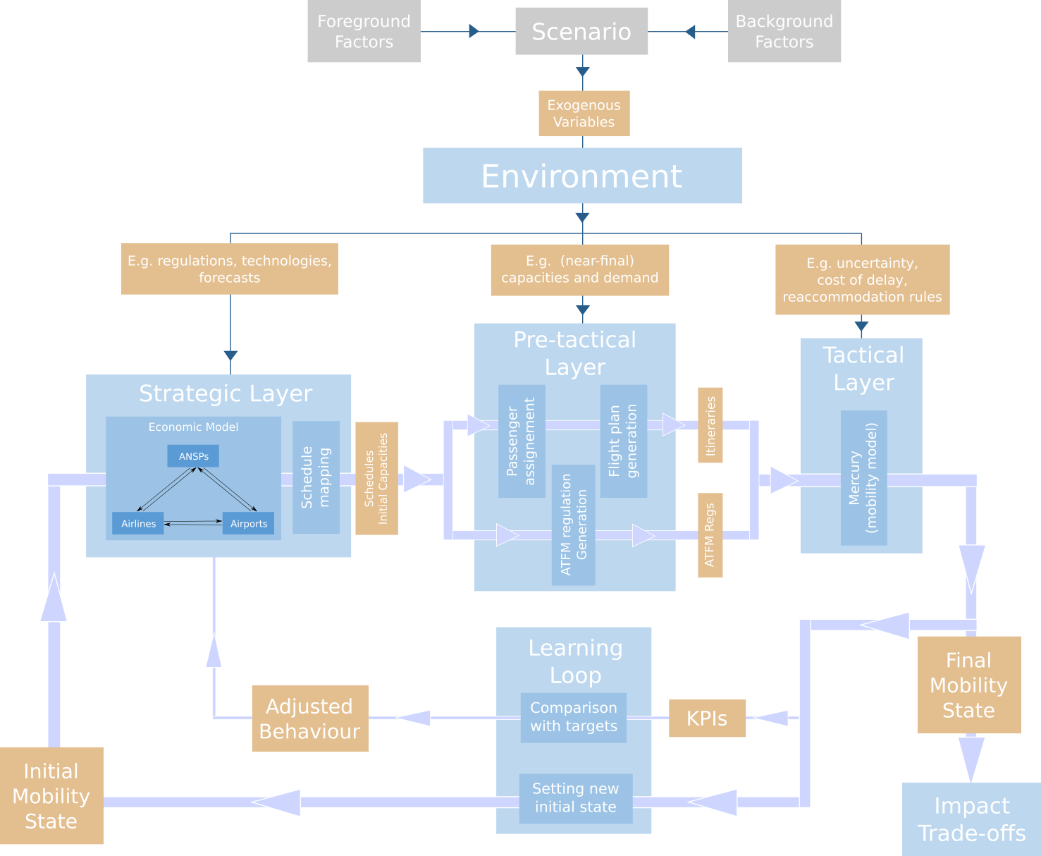
Model presentation

Slide 7
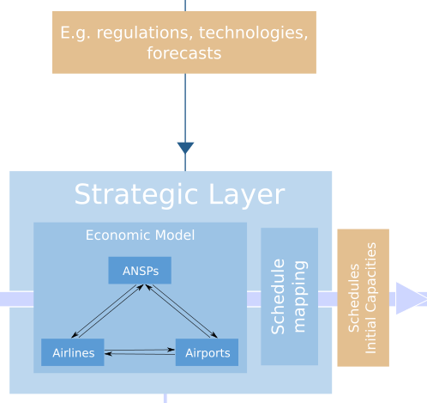
Strategic layer – economic model
Objective of the economic model: take into account macro-economic factors to forecast the main changes of flows in Europe.
Desired output:
Main flows in Europe,
Market share of different airline types
Capacities of ANSPs and Airports
Average prices for itineraries.

Slide 8
Strategic layer – economic model
Should take into account:
Main changes in demand:
volume
types of passengers
Major business models changes:
Point-to-point vs hub-based (airlines)
competition vs cooperation (ANSP)
privatization vs nationalisation (ANSP and airports)
Capacity restriction:
Congestion at airports
ATCO limits
Major changes of prices in commodities:
Fuel,
airport and airspace charges, etc

Slide 9
Model description
Deterministic agent-based model
In a nutshell:
Step-by-step multi-agent model
Individual agents are currently:
Individual airports
Individual airlines, part of alliances (or not)
Passenger aggregated at an OD level per airline
Individual ANSPs
Agents compete with peers, try to predict different values (delays, future demand, prices) and act accordingly

Slide 10
Network Based Model
Supply: airport pairs (edges)
Demand: itineraries (collection of edges)
Supply and demand? Price?
H
BAW
AFR
D
O
RYR

Slide 11
ABM flow
Airlines choose their supply, based on cost and price of tickets,
Passengers choose between different itineraries, based on prices,
Supply and demand are compared, prices evolve,
Agents compute profit and form expectations,
Short-list of airports assess a potential capacity extension,
ANSPs choose their capacity based on target and set their unit rate.

Slide 12
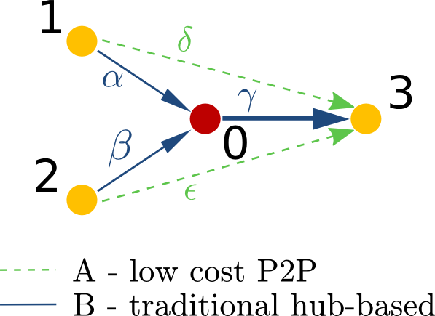
Simple example: LLC vs trad
Simplified setup: four airports, two airlines LCC/trad
Simple scenario:
Increase in demand (higher income) on 0->3
Increase of capacity of airport 3
Increased fuel price for everyone

Slide 13
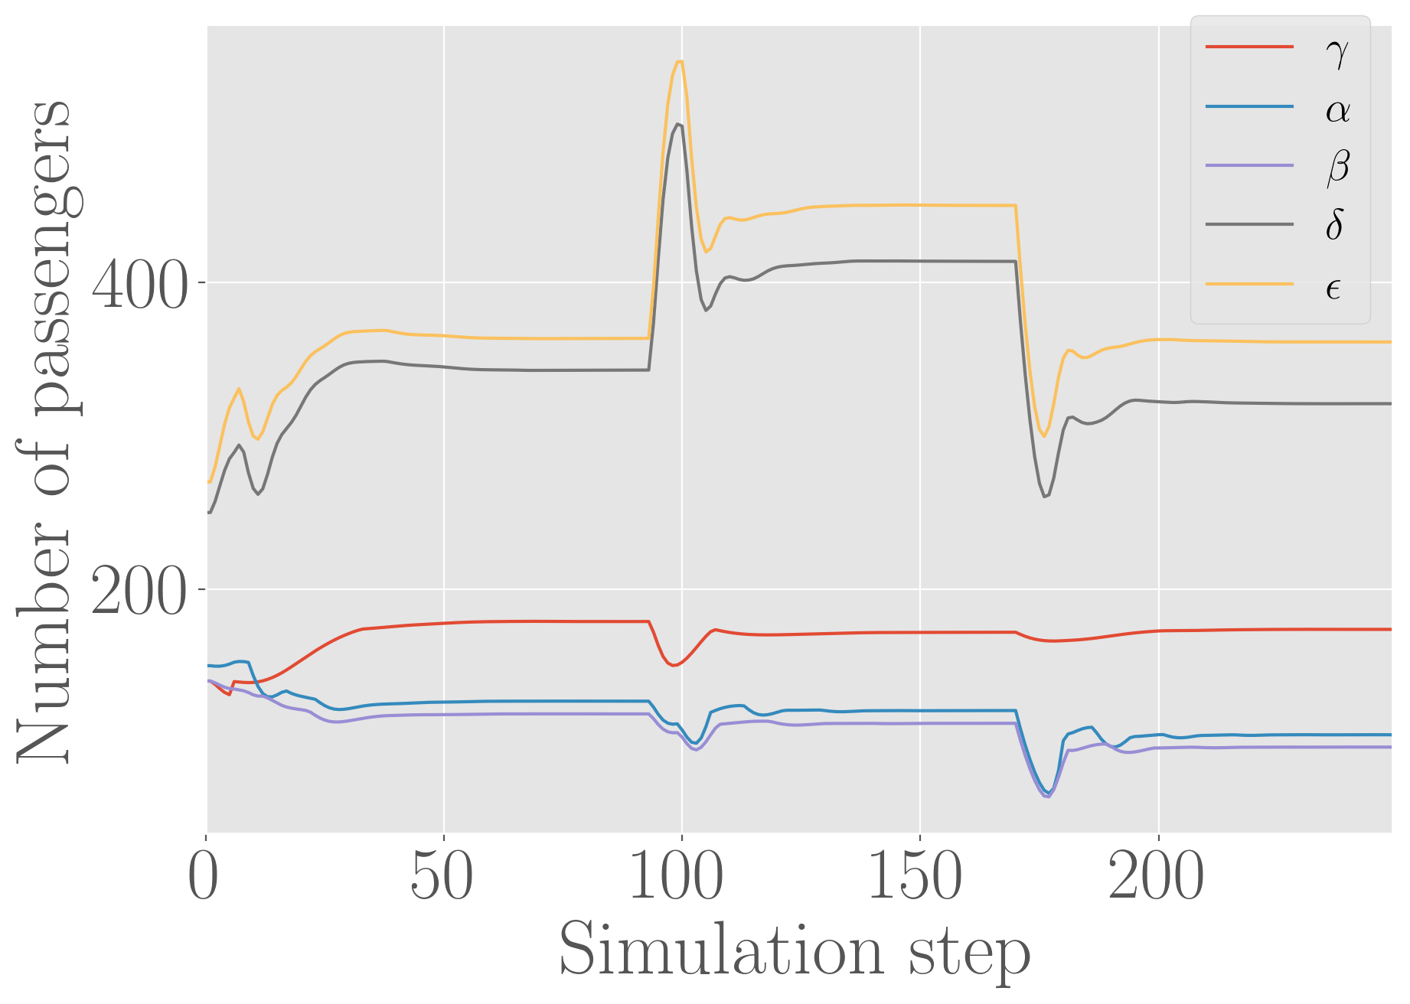
Number of passengers
Capacity increase
Price of fuel increase
Income increase
(trad. from hub)
(trad. to hub)
(trad. to hub)
(lcc)
(lcc)

Slide 14
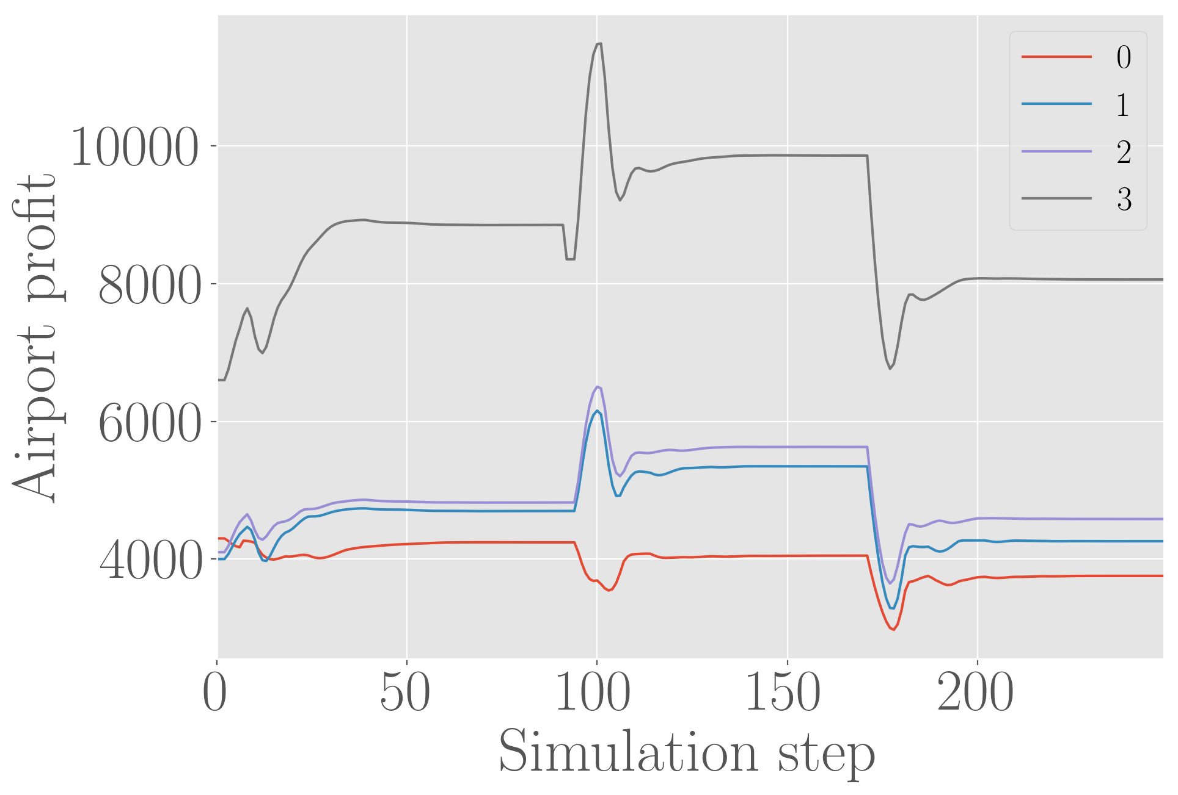
Airport profit
Capacity increase
Price of fuel increase
Income increase
(hub)
(origin)
(origin)
(final dest.)

Slide 15
Pre-tactical layer
From strategic high-level to tactical executable detail
Flight plans
Flight Schedules
ATFM delay
Passengers Flows
Passengers itineraries

Slide 16
Pre-tactical layer – flight plan generation
Schedules
Fid | From | To | SOBT | SIBT | Capacity | GCD | Ac type | …
F_{AD1} | A | D | 9:00 | 10:30 | 120 | 1234 | A320
F_{AD2} | A | D | 10:45 | 12:20 | 240 | 954 | A320
F_{AD3} | A | D | 10:50 | 12:20 | 120 | 2521 | B737
F_{CD1} | C | D | 8:30 | 12:00 | 70 | 3213 | B737
…
Flight plans
Fid | Flight plan type | Climb dist | Climb time | Cruise dist | Cruise time | Cruise speed | Cruise avg Fl | Cruise avg weight | Cruise avg wind | Descent dist | Descent time
F_{AD1} | 0 | 208 | 00:29 | 504 | 1:07 | 445N (0.77M) | 380 | 66500 | 34 | 201 | 00:35
F_{AD1} | 1 | 213 | 00:31 | 442 | 1:00 | 450N (0.78M) | 360 | 67000 | -9 | 224 | 00:36
F_{AD1} | 2 | 194 | 00:29 | 472 | 1:07 | 446N (0.77M) | 380 | 66000 | -24 | 201 | 00:35
F_{AD1} | 3 | 208 | 00:29 | 466 | 1:02 | 450N (0.77M) | 340 | 67500 | 0 | 218 | 00:36
…

Slide 17
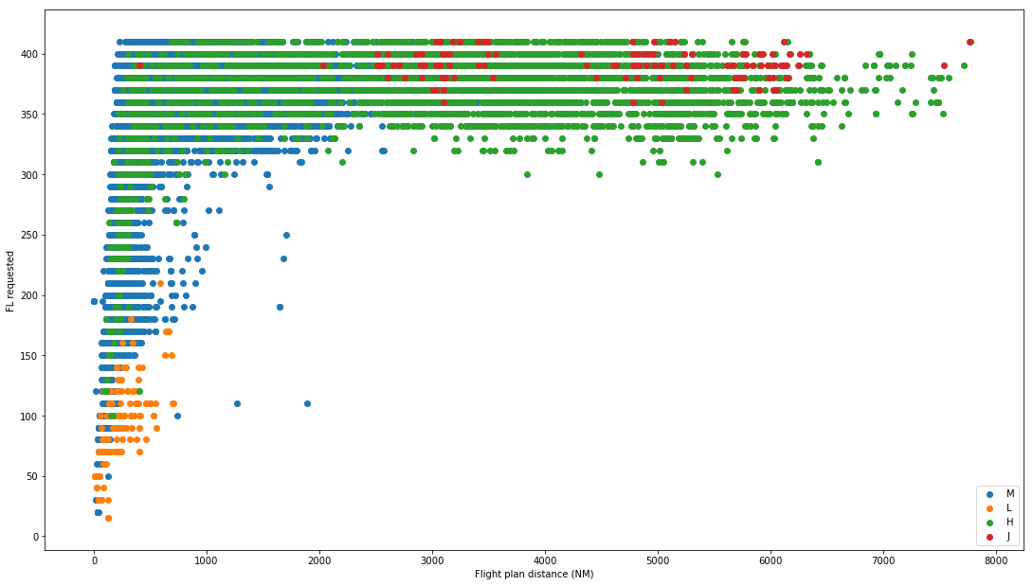
Pre-tactical layer – flight plan generation
Flight level requested
Flight plan distance (NM)

Slide 18
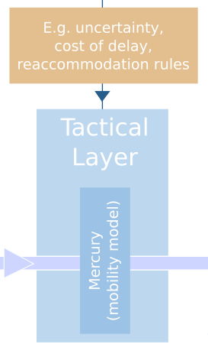
Tactical layer -- Mercury
Flight plans
Tactical delays, reaccomodations,
etc
ATFM delay
Passengers itineraries

Slide 19
Tactical layer -- Mercury
Data-driven mesoscopic approach, stochastic modelling
Individual passenger DOOR-TO-DOOR itineraries
Regulation 261/2004 – pax care & compensation
Disruptions, cancelations, re-accommodations, compensations costs
Airline decisions based on costs models or rule of thumb
Full Air Traffic Management model, demand/capacity balance

Slide 20
Conclusions
Overall model:
Aim at simulating what happens a typical day of if you change something in the system.
Macro to micro model in different layers of increasing detail
Economic model:
High-level description, dependence of main flows on macro-economic parameters.
Deterministic agent-based model, featuring ANSPs, airlines, airports and passengers
Complex economic feed-back, emerging phenomena coming from network-based interactions

Slide 21
Potential next steps
Academic developments:
Study of emergent phenomena related to more specific changes in the model, for instance introduction of different drone management systems
Refinements of the economic side of the model by extending the financial aspect: capital of companies, loans, etc.
Refinements of the strategies used by agents, game theory.
Application-oriented development:
Support to projects like PJ19, development of performance tools and general views like EATMA
Support to projections of demand at the ANSP level (stakeholder demand)

Slide 22
Vista project
Thanks for listening!

Slide 23
Passenger demand
Pax demand: given all the possibilities (itineraries) to go from i to j with associated prices, travel times, etc, how to choose one?
$$D_{k}= D_{k}^{0}\left(1−α∆p_{k}+ β∆i_{k}+ …\right)C(p_{k}, \{p_{l}\}_{l≠k})$$
Volume term
Competition term
$$C(p_{k}, \left\{p_{l}\}_{l≠k}\right)=1−\frac{1}{s}\left(∆p_{k}−\sum_{l=1, l≠k}^{n}{\frac{∆p_{l}}{n−1}}\right)+ …$$

Slide 24
Airline supply
Airline supply: profit maximizer, choosing their capacity on each branch.
$$r=S\hat{p} −c(S)$$
$$c\left(S\right)=c+c_{o}S+ c_{c}S^{α}$$
$$α>1$$
Overhead, constant
Cost of capital, superlinear
Operational cost, linear
$$S^{∗}={\left(\frac{\hat{p}−c_{o}}{c_{c}}\right)}^{\frac{1}{α−1}}$$

Slide 25
Airline supply
Operational cost depends on a lot of parameters:
$$c_{o}=χΔ{δt}_{O}+χΔ{δt}_{D}+c_{f}\left(d\right)+c_{ATC}+…$$
Cost of delay
Cost of fuel
ATC charges

Slide 26
Market clearing and convergence
Demand disaggregated itineraries -> airport pair
Demand and supply are compared on each edge, price is updated:
$$p_{t+1}^{k}=p_{t}^{k}\left(1+λ\left(\frac{S_{k}−D_{k}}{{(S}_{k}+D_{k})/2}\right)\right)$$

Slide 27
Airport delay management
Airports compute their total traffic, which produces an extra level of delay given by
Traffic
$$δt=δt_{0}+\frac{T}{C}$$
Capacity (fitted)
Airports try to maximise their profit by increasing (or not) their capacity:
$$r=T\hat{P}−c(C)$$
Cost of capacity
(linear in the model)

